Slide 1
Quantifying L2 vowel categories in acoustic space Distinctiveness and nativelikeness metrics in R
Joan Borràs-Comes
Laboratori de Fonètica, Universitat de Barcelona
3rd Methodological Workshop on the Acquisition of L2 Speech

Slide 2
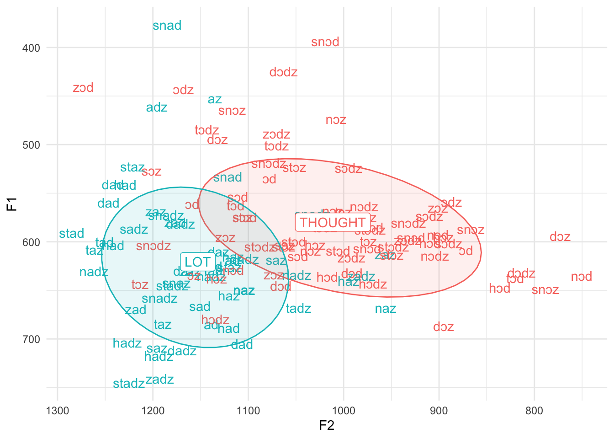
The central problem
What does “distance between vowels” actually mean?
When we analyse vowel systems in acoustic space, we often make statements such as:
“The contrast is clearer.”
“The categories overlap.”
“Learners produce more native-like vowels.”
These expressions suggest that we are talking about distance between categories.
Mathematically, these statements may refer to very different properties of the vowel space: different phonological questions require different quantitative measures.

Slide 3
/æ–ʌ/
Consider this English contrast produced by Spanish learners.
We compare:
a focal group of Spanish L1 learners
a reference group of native English speakers
We may imagine several possible learner systems:
A native-like system
A merged system where /æ/ and /ʌ/ overlap
A displaced system where categories exist but occupy different regions
Different metrics may capture these scenarios in different ways.

Slide 4
Vowel categories as distributions
Vowel categories are distributions in acoustic space.
Typically analysed using measurements such as [F1, F2] or [B1B0, B2B1].
Categories are represented not by a single point, but by a cloud of tokens.
Every cloud has two fundamental properties:
A central tendency: The mean or centroid of the category
A covariance structure: The spread and orientation of the tokens around that centroid
When we plot vowel tokens in acoustic space, we often observe elliptical clouds (and they graphically represent the covariance matrix).

Slide 5
Three phonological questions
Dispersion of exemplars | Category separation | Target proximity
How large or variable is a vowel category? | How distinct are two phonological categories? | How similar is a learner system to a reference system?
Do speakers produce consistent tokens? Or are productions highly variable? | Are /æ/ and /ʌ/ clearly separated? Or do they overlap in acoustic space? | Do learner productions resemble those of native speakers? Or do they diverge systematically?
This question concerns the internal spread of a category. | This question concerns the distance between two categories within a system. | This question concerns the relationship between two entire systems.
Each of these questions focuses on a different geometric property of the vowel space. As a result, they require different quantitative metrics.

Slide 6
Data constraints: dimensions and tokens
When analysing vowel clouds, the available information depends on two crucial factors.
Dimensionality (p)
How many dependent variables we consider (F1, F1 & F2, F0 & F1 & F2, B1B0 & B2B1…)
Higher dimensionality allows us to capture more detailed structure of vowel categories, but also increases the complexity of the statistical models.
Number of tokens (n)
How many tokens are available for each category?
Some metrics require many observations to estimate covariance matrices reliably.
With very small datasets, certain metrics may become unstable or impossible to compute.

Slide 7
Different questions require different metrics
No single metric captures all aspects of vowel systems.
In this talk, we will look at five measures:
Determinant of covariance ∣Σ∣
Euclidean distance d_{E​}
Mahalanobis distance D_{M}
Pillai trace V_{P}
Bhattacharyya distance D_{B}
Each metric:
corresponds to a different mathematical idea of distance
may give a different interpretation of a single dataset

Slide 8
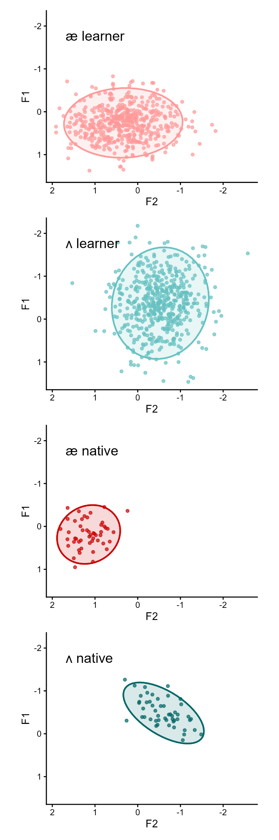
Determinant of covariance

Slide 9
Determinant of covariance
The covariance matrix describes the shape of a vowel cloud in acoustic space (spread, orientation, and correlation between dimensions).
Its determinant (a.k.a. generalized variance) is proportional to the area of the dispersion ellipse. Therefore, it captures the overall size of the category:
small determinant → compact category
large determinant → highly variable category
A very elongated but narrow cloud can have the same determinant as a more circular one; the determinant does not capture shape, only overall dispersion.

Slide 10
Determinant of covariance
Vowel categories may differ in their internal variability.
The determinant of the covariance matrix provides a simple quantitative measure of this dispersion.
In phonological terms, greater dispersion may reflect:
unstable production
increased phonetic variability
reduced category control
Unlike convex hull measures, covariance-based measures are less dependent on a few extreme tokens.

Slide 11
Determinant of covariance
Few articles measure vowel dispersion using the determinant of covariance, but:
Distance measures such as Mahalanobis and Bhattacharyya are widely used, and they rely on the same covariance matrix.
Vowel categories are treated as a bivariate or multivariate distribution in acoustic space (i.e., not relying on examining F1 and F2 separately), so considering both the dispersion and the orientation.
The determinant can be understood as a derived scalar measure summarizing the global dispersion encoded in the covariance structure.
And it is used across many fields: geometric morphometrics, morphospace and floral disparity, ecological niche modeling, behavioral neuroscience, genomics, etc.

Slide 12
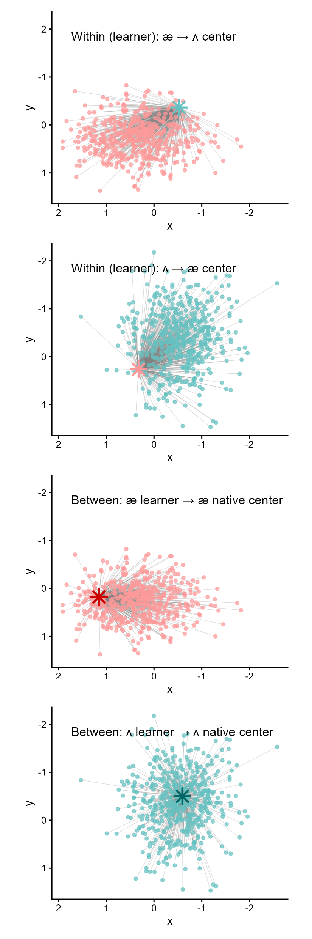
Euclidean distance

Slide 13
Euclidean distance
Euclidean distance is the most familiar notion of distance.
It measures the straight-line distance between two points in space.
These points may correspond to individual tokens or category centroids.
It is intuitive and easy to interpret. It derives from the Pythagorean theorem.

Slide 14
Euclidean distance
Euclidean distance is computed only between two points. Therefore:
It ignores the shape of the distributions (the covariance structure).
It assumes that all directions in the space are equivalent.
However:
Vowel categories may have very different distributions (more elongated, more compact…)
Even when centroid distances are identical, the perceptual or phonological separation between categories may differ.
As a result, Euclidean distance may fail to capture important aspects of vowel-space structure.

Slide 15
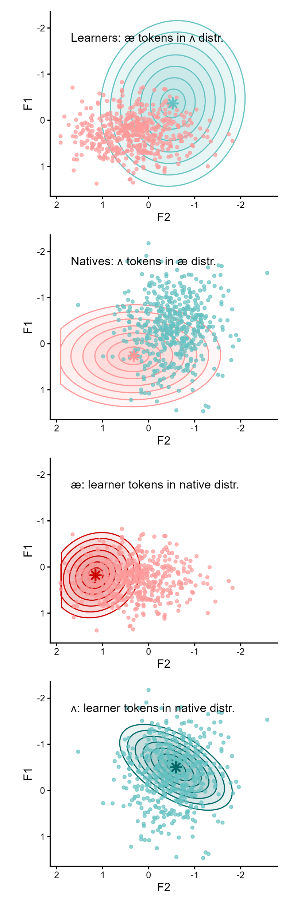
Mahalanobis distance

Slide 16
Mahalanobis distance
Mahalanobis distance extends Euclidean distance by taking into account the covariance structure of the reference distribution.
Instead of measuring distance in raw acoustic space, it measures distance relative to the shape of the reference distribution.
As a result, the same Euclidean distance can correspond to very different positions relative to the reference category.

Slide 17
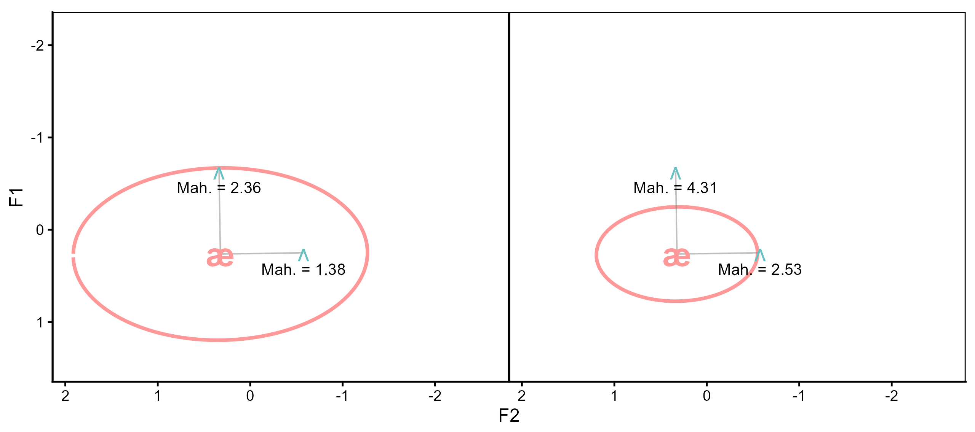
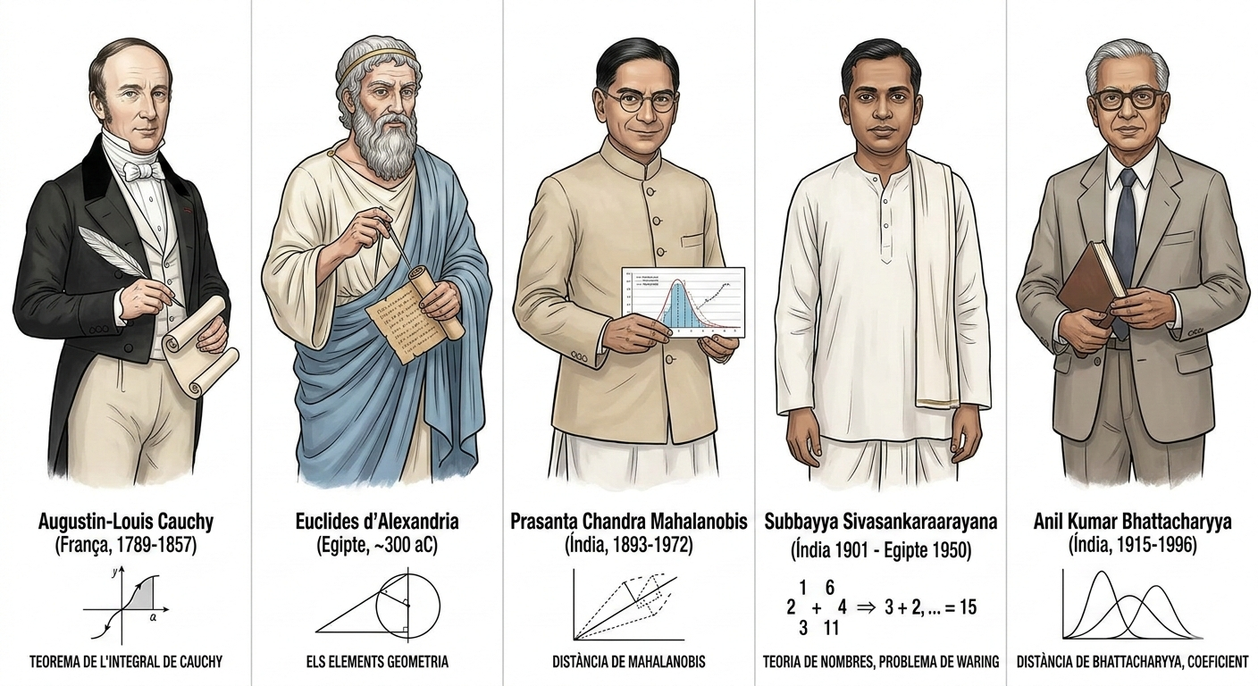
Mahalanobis distance
It is computed relative to the reference distribution:
its overall dispersion (variance) — “how big”
its directional structure (covariance) — “how elongated”
Same Euclidean distance: 0.90 for all four cases

Slide 18
Mahalanobis distance
Mahalanobis distance has been widely used in acoustic phonetics: Nearey (1977, 1989), Hillenbrand et al. (1995), Wassink (2006).
It provides a distribution-aware measure of distance. It measures the distance between a point and a reference distribution, and therefore it captures:
how typical a token is relative to a target category
how far learner productions lie from a native distribution
This makes Mahalanobis distance particularly useful for between-group comparisons, such as measuring the distance of productions from a target phonological category.

Slide 19
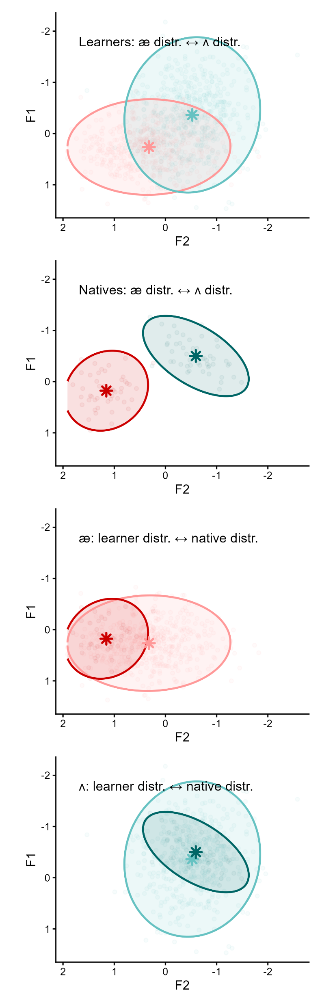
Pillai trace & Bhattacharyya distance

Slide 20
Pillai trace
Pillai trace is a statistic derived from MANOVA (Multivariate Analysis of Variance).
Therefore, it is based on a linear model and involves statistical assumptions.
It measures how much of the variance in the data is explained by a categorical factor (e.g., vowel category).
It reflects the degree to which categories occupy distinct regions.
Higher values indicate clearer category separation, i.e., less overlap between distributions.
Widely used in (socio)phonetics to quantify vowel mergers and contrasts.

Slide 21
Bhattacharyya distance
Bhattacharyya distance measures the difference between two probability distributions.
Particularly useful for measuring distributional overlap between categories.
Bhattacharyya distance increases as two distributions become more distinct.
Small values → strong overlap
Large values → clear separation
Because it incorporates both mean differences and covariance structure, it captures more aspects of vowel geometry than simpler metrics.

Slide 22

Pillai vs Bhattacharyya /1
Both measures
rely on covariance matrices (no need for normal distributions)
can be computed for one or multiple dependent variables
require sufficient observations for each data cloud to estimate covariance matrices (n observations > n variables)
Bhatt. is usually computed pairwise, whereas Pillai extends to comparisons involving multiple groups.

Slide 23
Pillai vs Bhattacharyya /2
Pillai primarily reflects centroid separation relative to within-category variance, while Bhattacharyya additionally captures differences in dispersion and covariance structure.
Pillai == 0 → coincident centroids
Bhatt. == 0 → identical distributions
They use a different range of values:
Pillai: 0 – 1
Bhatt.: 0 – ∞

Slide 24
Pillai vs Bhattacharyya /3
Both measures can be used as summary measures of category separation and then analysed statistically when comparing speakers, groups, or conditions.
Pillai trace is commonly used to test phonological contrast, whereas Bhattacharyya distance is typically used to quantify acoustic overlap between categories.

Slide 25
0.456
0.893
0.131
0.005
0.639
5.578
0.534
0.223
Pillai
Bhattacharyya

Slide 26
Take-home message
No single metric fully captures the structure of vowel systems, but multiple perspectives are required.
Different metrics emphasise different aspects of the data:
dispersion
centroid distance
covariance structure
distribution overlap
similarity to a reference system
Choosing an appropriate metric therefore depends on the phonological question being asked (and the amount of available data).

Slide 27
R functions
Two R functions have been implemented to measure all these values
detcov()
detcov
voweldist()
euc_wit, euc_bet, mah_wit, mah_bet, pil_wit, pil_bet, bha_wit, bha_bet
_wit = within-system distinctiveness
_bet = between-system distance to the native reference

Slide 28
From concepts to implementation
In the practical session, we will:
inspect vowel clouds visually;
compute within-system distinctiveness metrics;
compute between-system nativelikeness metrics;
compare the metrics statistically in R.

